Slide 1

BS CAPSTONE
FINAL PROJECT
$100K MRR TEAM

Slide 2
Team Introduction
Nathan
Role: Frontend Developer, Designer, DevOps
Responsibilities: Design & Build Frontend, Deploy App
Slater
Role: Backend Developer, DB Admin
Responsibilities: Build API, Design Database

Slide 3
Emotial Overview
The social platform for sharing your thoughts & feelings.
Full featured text-based social media
Unique emoji reaction system
User accounts
  Avatars/Banners
  Following/Friends
Posts (with images, GIFs, or a video)
  Replies
  Sharing
  Hashtags/Mentions
Realtime Notifications
Multiple Themes

Slide 4
Timeline
Week | Highlights
1 | Init frontend & backend, wired up boilerplate for the app, setup hosting.
2/3 | Built profiles, avatars/banners/media, followers, search, live notifications, basic mobile layout.
4 | Auth pages and login/signup, setup themes.
5 | Frontend polish, Docker/CI, account settings, and media cropping

Slide 5
Timeline (Continued)
Week | Highlights
6 | Admin functionality, mentions/hashtags, emoji styles
7 | Shares, emoji picker, image uploading/CDN, OpenGraph, reaction list
8 | Feed sorting, theme accents, friends/suggestions, drag-and-drop media
9 | Live new post updates, crop/zoom polish, and remaining bug fixes

Slide 6
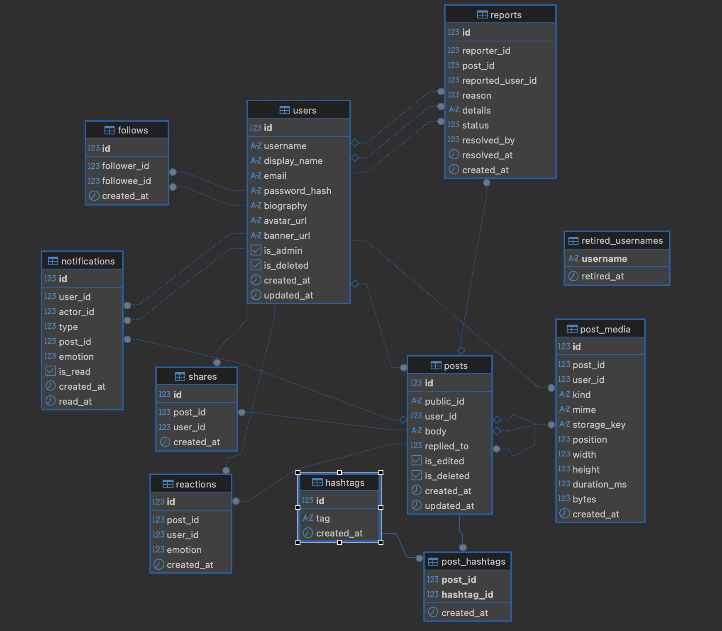
Database ERD

Slide 7
Obstacles Overcome
Frontend:
Rich Text Editor w/ mentions, hashtags, and links
Media normalization/uploading in background
Type safety between frontend & backend
Emoji styles

Slide 8
Obstacles Overcome
Backend:
Creating an OpenAPI Specification
Server-sent Events
PostgreSQL on a large scale application.

Slide 9
Technical Design
Frontend:
Next.js app with React client components fetching data via TanStack Query.
API client generated from the backend's OpenAPI spec, keeping types in sync automatically.
User interactions update the UI optimistically, then sync with the server in the background.
Live feed and notification updates arrive over server-sent events.

Slide 10
Technical Design
Backend:
Go REST API built on Gin and Huma. Huma generates OpenAPI spec from models and handlers.
API Handlers -> Service Layer -> GORM -> Postgres
Auth w/ JWTs stored as a cookie.
Live feed and notification updates are pushed over server-sent events.

Slide 11
Technical Design
Deployments:
We deploy the app on one of Slater’s servers. We are using Docker to deploy frontend, backend, Postgres, and MinIO containers which all connect over the local network.

Slide 12
Summary
Overall this project was fun for us, we had a lot of support and good ideas going in so our focus was on executing and making the platform feel nice to use.

Slide 13
Live Demo
emotial.app

Slide 14
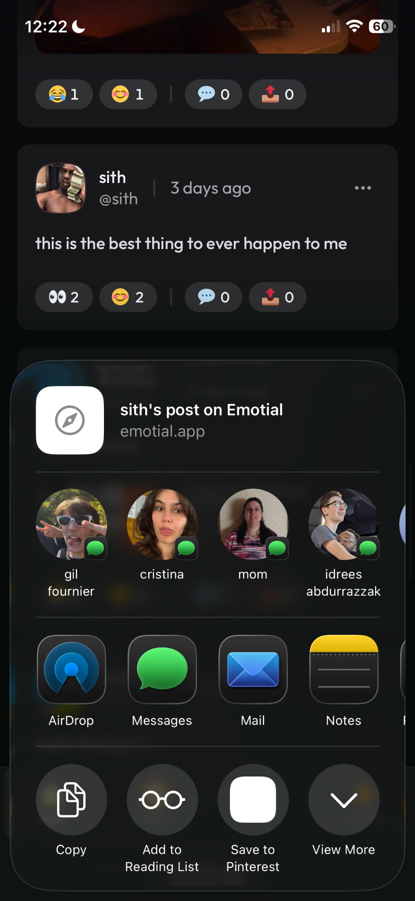
Sharing on Mobile

Slide 15
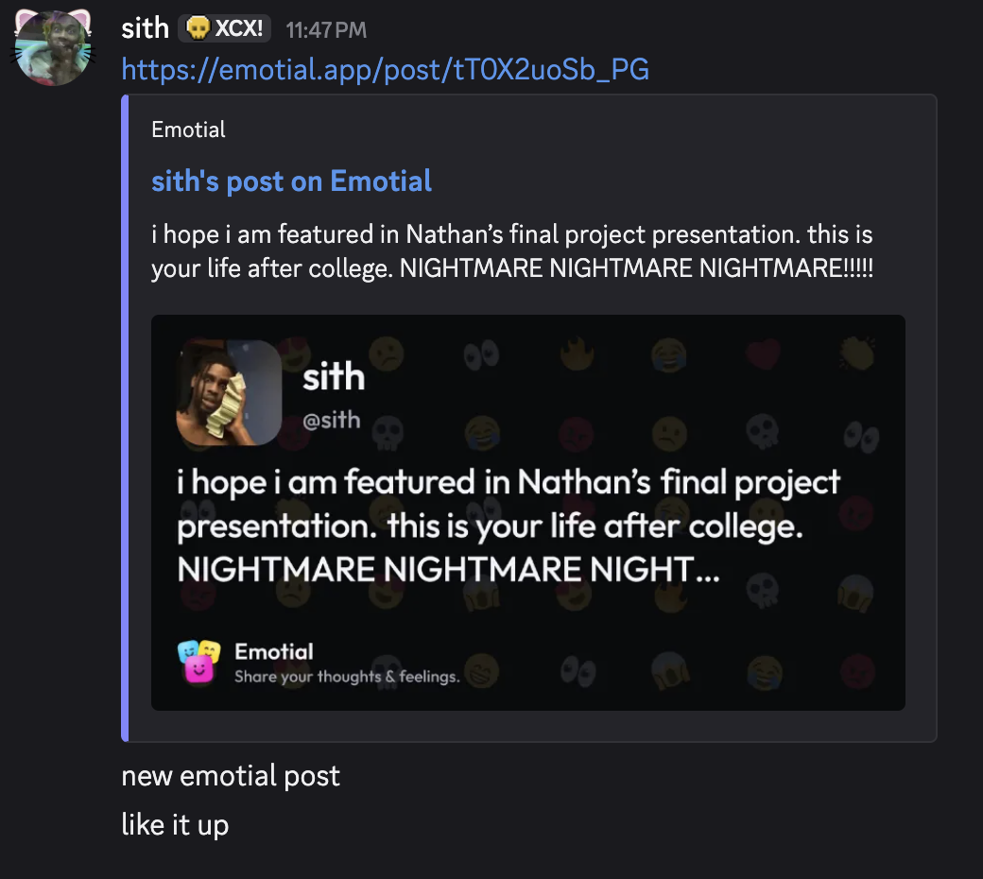
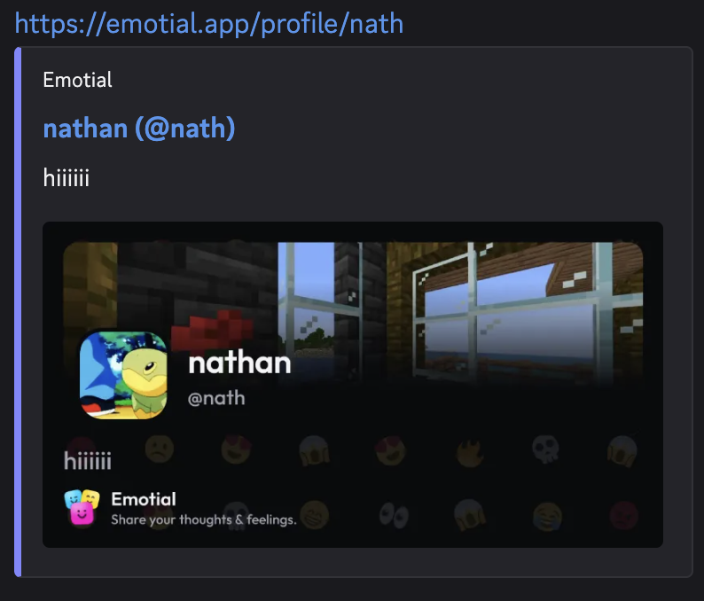
OpenGraph

