Slide 1
Social Media
Web Application
{
$100K MRR Team
}
...

Slide 2
Team Members
Nathan Lodge-
Frontend Developer
Designer
Slater Leonardo-
API
Database
}
..

Slide 3
Project Overview
This will be a full featured social media with a unique emoji reaction system.
Including everything you’d expect like:
User accounts
Posts (with images, GIFs, or a video)
Reactions
Replies
Sharing
Hashtags/mentions
It will also support extra features like realtime notifications, a developer bot API, and multiple themes to choose from.

Slide 4
Tech Stack
Frontend:
Next.js / React
Tailwind CSS
TypeScript
Socket.io Client
Services:
GitHub
Cloudflare
Google OAuth (maybe)
Backend:
Golang
Gin (Go API Router)
Gorm (Go ORM)
Socket.io Server
Infrastructure:
PostgreSQL
Docker
Minio S3 (Blob Storage)

Slide 5
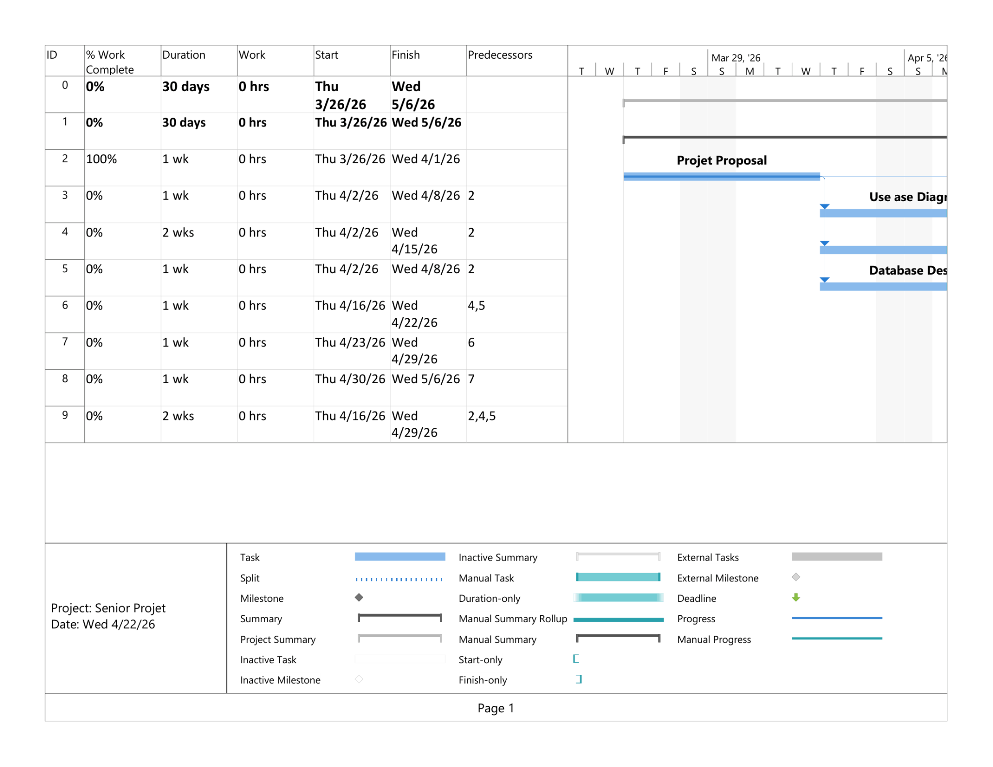
Gantt Chart
}
..

Slide 6
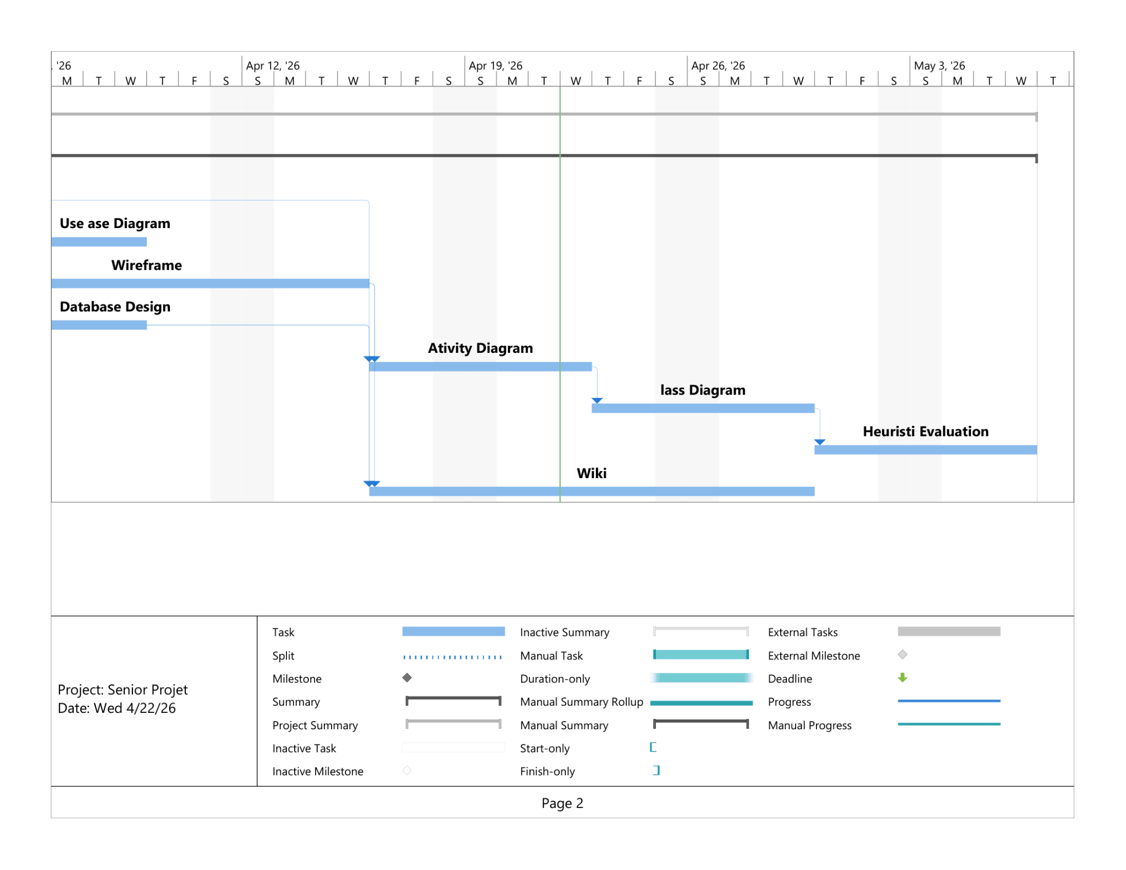
Gantt Chart (continued)
}
..

Slide 7
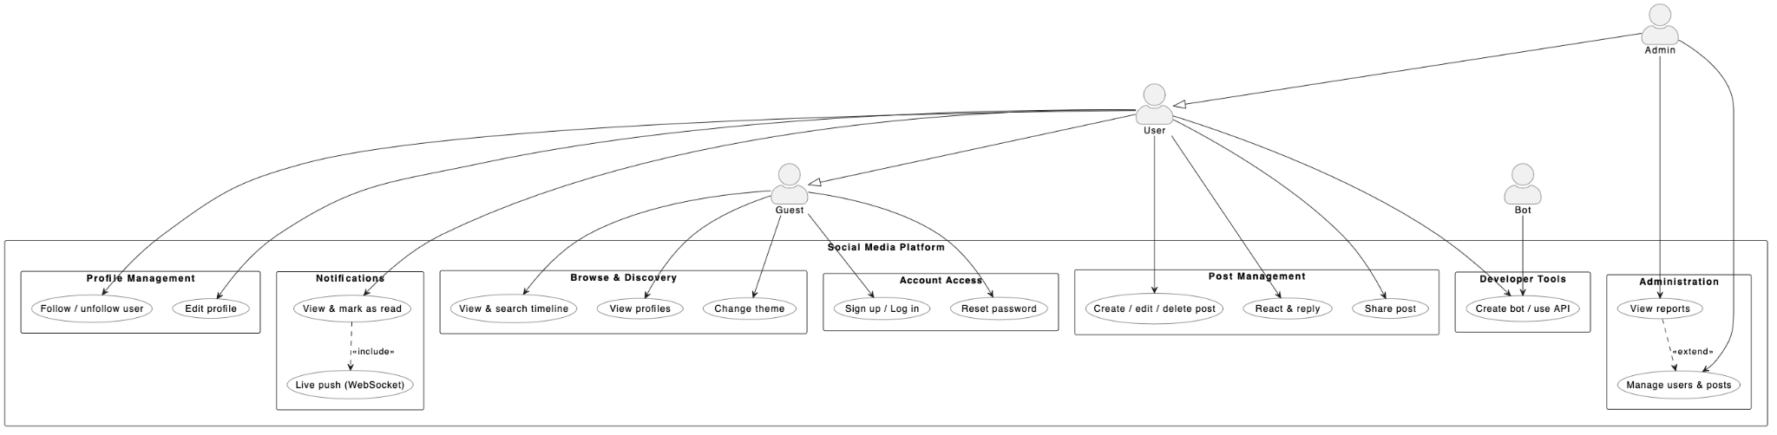
Use Case Diagram
}
..

Slide 8
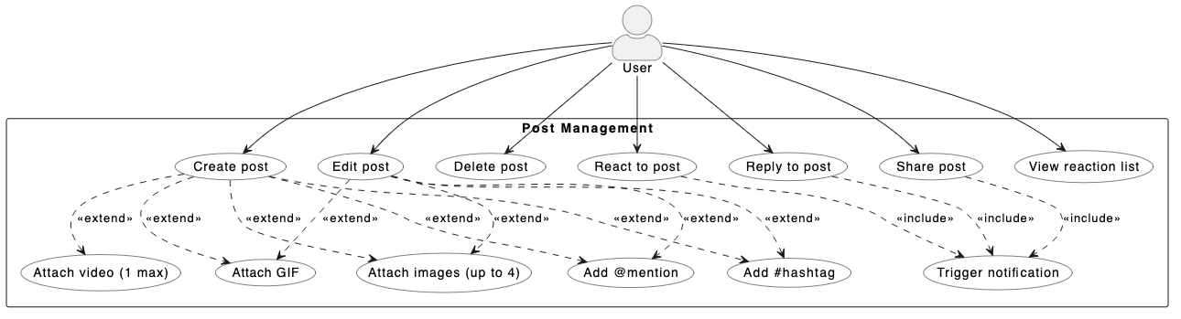
Use Case Diagram (Post Management)
}
..

Slide 9
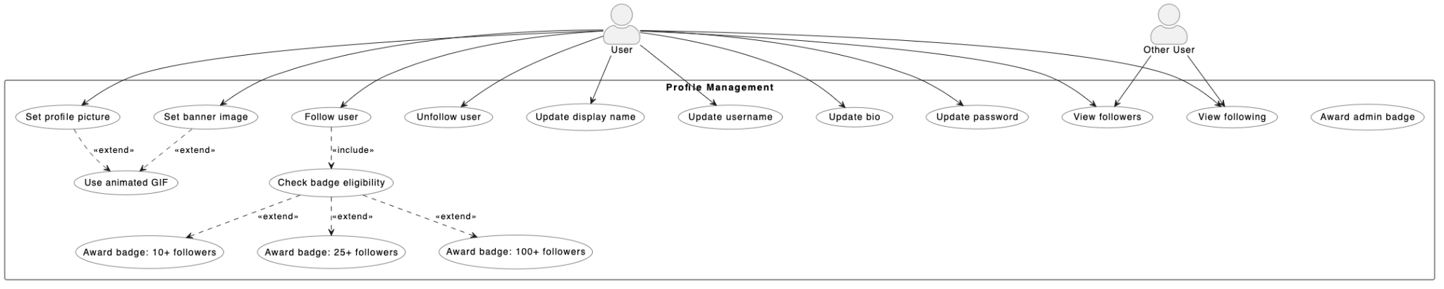
Use Case Diagram (Profile Management)
}
..

Slide 10
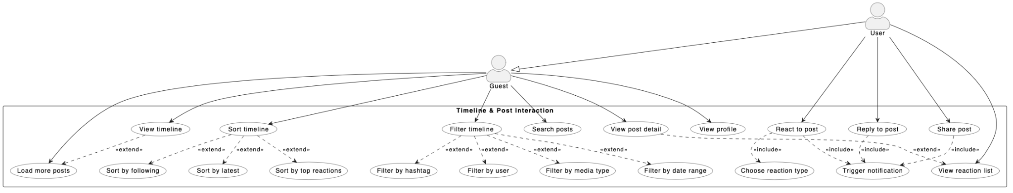
Use Case Diagram (Timeline)
}
..

Slide 11
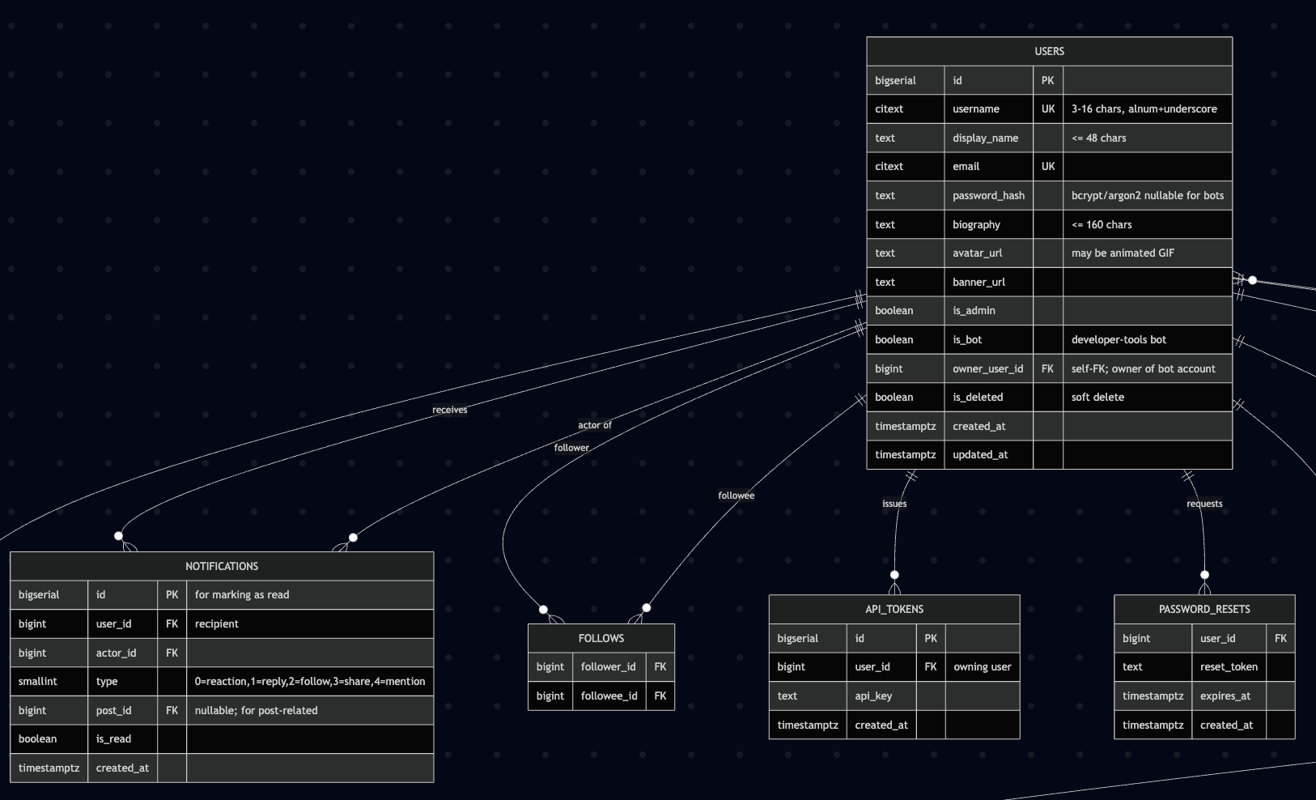
ERD - Account
}
..

Slide 12
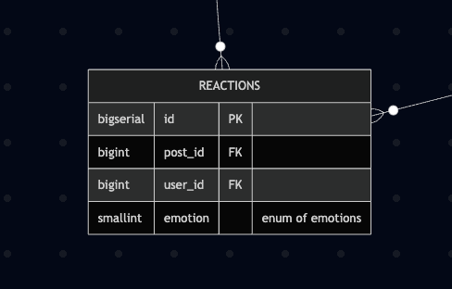
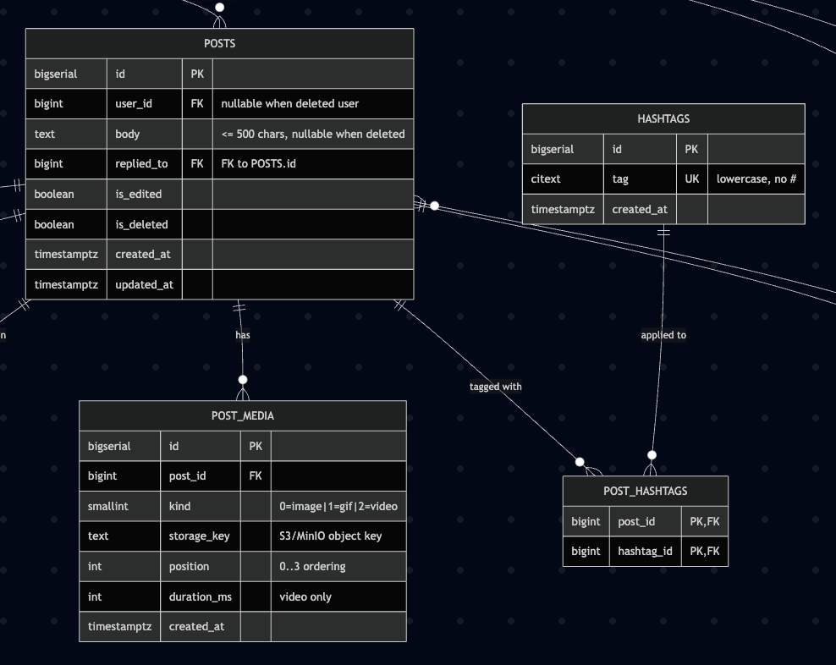
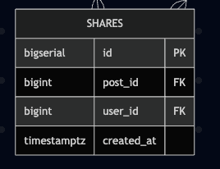
ERD - Posts
}
..

Slide 13
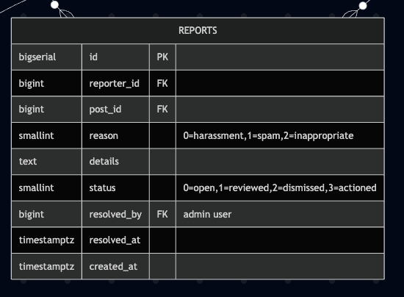
ERD - Admin
}
..

Slide 14
Entity Relationship Diagram
link to ERD
}
..

Slide 15
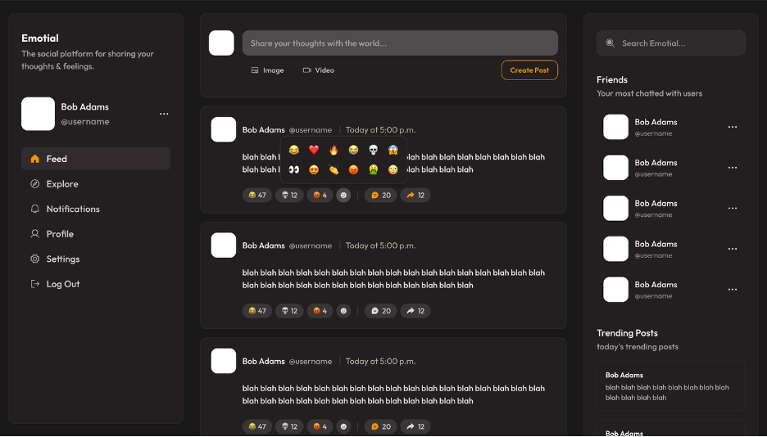
Wireframe (Feed)
}
..

Slide 16
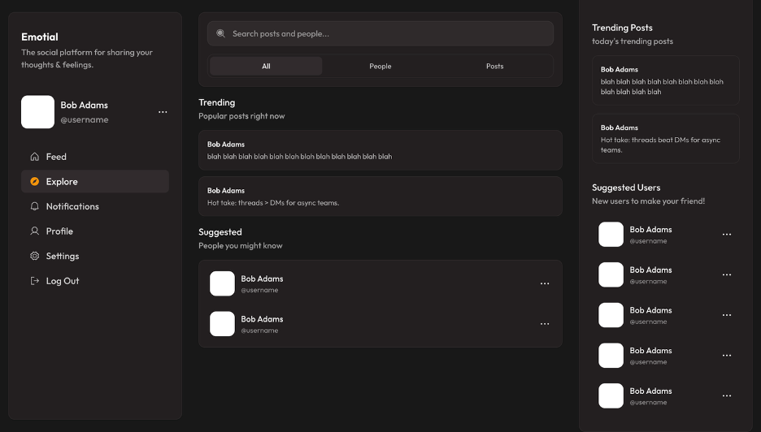
Wireframe (Explore)
}
..

Slide 17
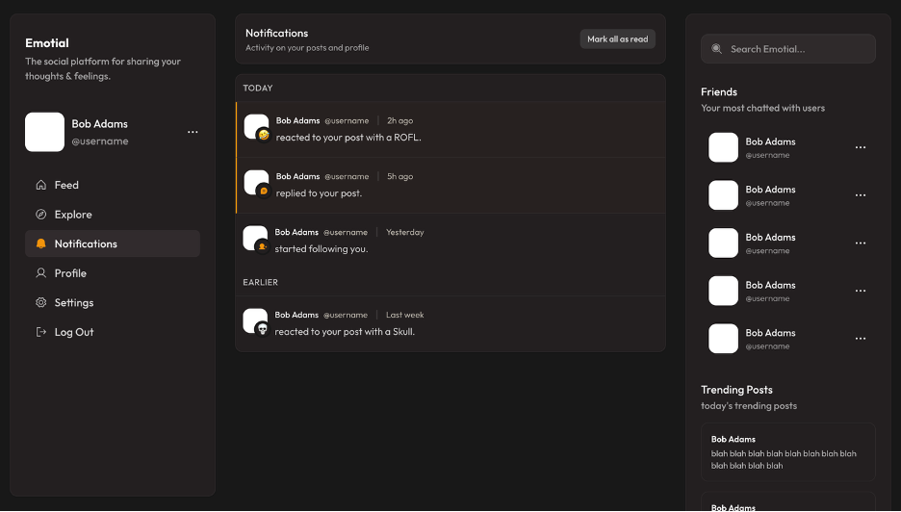
Wireframe (Notifications)
}
..

Slide 18
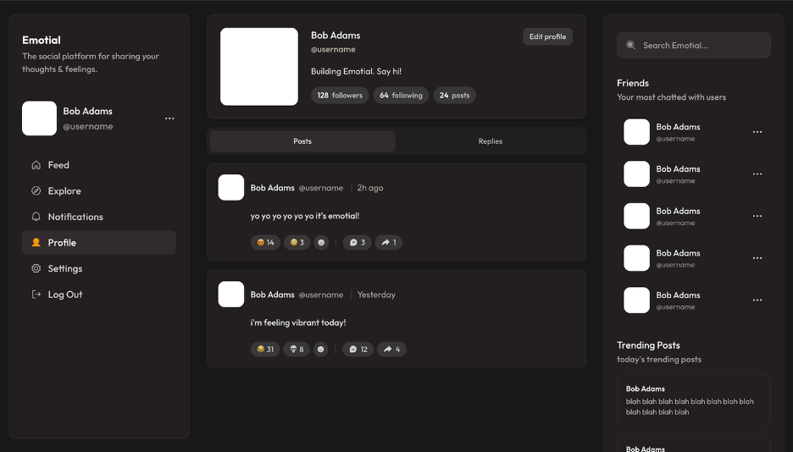
Wireframe (Profile)
}
..

Slide 19
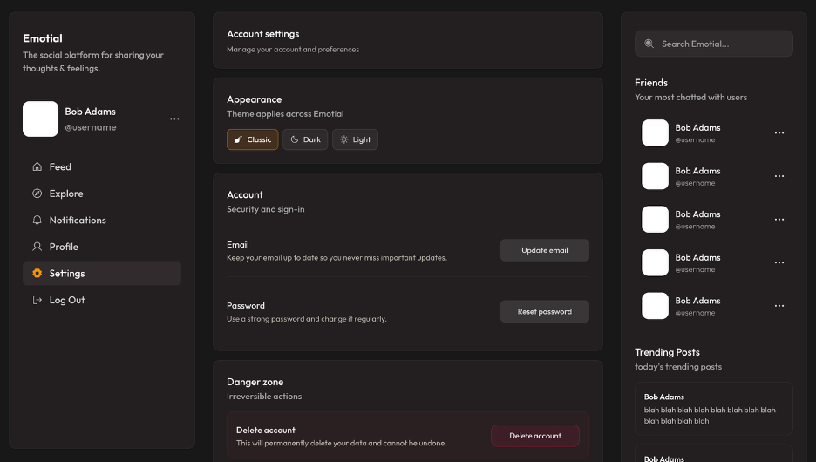
Wireframe (Settings)
}
..

